Slide 1
Digital Image Processing Chapter 7: Morphological Image Processing

Slide 2
Contents
Mathematical morphology provides tools for the representation and description of image regions (e.g. boundary extraction, skeleton, convex hull).
It provides techniques for pre- and postprocessing of an image (morphological thinning, pruning, filtering).
Its principles are based on set theory. Applications to both binary and graylevel images.

Slide 3
Preliminaries
Morphological image processing is a collection of non-linear operations related to the shape or morphology of features in an image.
Wikipedia: morphological operations rely only on the relative ordering of pixel values, not on their numerical values, and therefore are especially suited to the processing of binary images.
Morphological operations can also be applied to greyscale images with some help of light transfer functions.

Slide 4
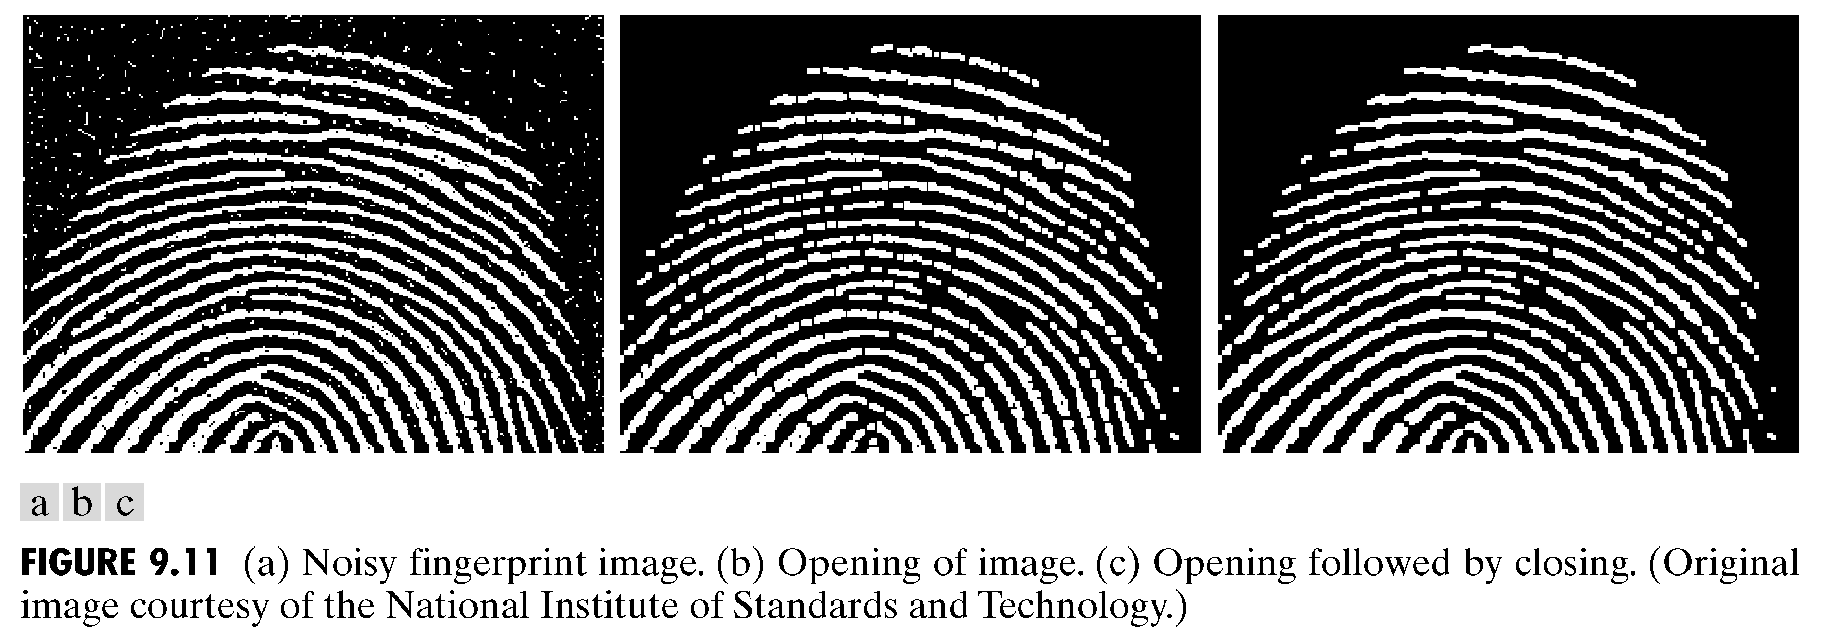
Preliminaries
Once the segmentation is complete, morphological operations can be used to remove imperfections in the segmented image and deliver information on the shape and structure of the image.
Image after segmentation
Image after segmentation and morphological processing

Slide 5
Preliminaries
The four horizontal and vertical neighbors of a pixel p are called 4-neighbours of p and are denoted by N₄(p).
So a pixel p at coordinates (x, y) has two horizontal and two vertical neighbors with coordinates: (x+1, y), (x−1, y), (x, y+1), (x, y−1)
The four diagonal neighbors of a pixel p are denoted by N_{D}(p) which includes: (x+1, y+1), (x+1, y−1), (x−1, y+1), (x−1, y−1)
N₄(p) plus N_{D}(p) are called the 8-neighbours of pixel p and are denoted by N₈(p).

Slide 6
Preliminaries
Adjacency of pixels:
Let V be the set of intensity values used to define the adjacency (e.g. V={1} for binary images).
4-adjacency: Two pixels p and q with values in V are 4-adjacent if q is in N₄(p).
8-adjacency: Two pixels p and q with values in V are 8-adjacent if q is in N₈(p).
m-adjacency (mixed adjacency): Two pixels p and q with values in V are m-adjacent if
q is in N₄(p), or
q is in N_{D}(p) and the set N4(p) ∩ N4(q) has no pixels whose values are in V

Slide 7
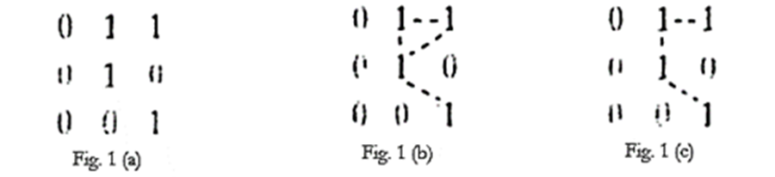
Preliminaries
Adjacency of pixels:
Mixed adjacency is a modification of the 8-adjacency. It is introduced to eliminate ambiguities of 8-adjacency.
Consider the pixel arrangement shown in Fig.1(a) for V = {1}. The three pixels at the top of Fig.1(b) show multiple (ambiguous) 8-adjacency, as indicated by the dashed lines. This ambiguity is removed by using m-adjacency, as shown in Fig.1(c). Thus in this manner, mixed adjutancy is introduced, to eliminate such the ambiguities.

Slide 8
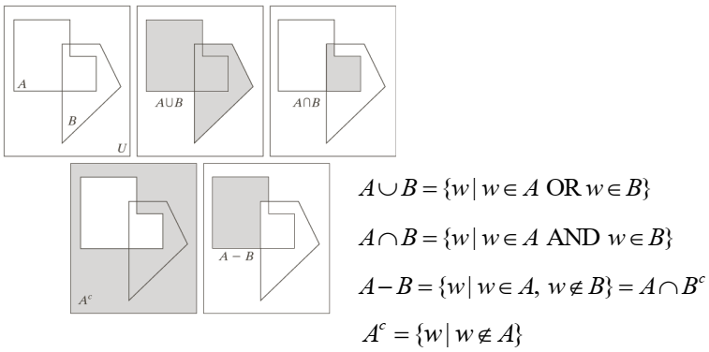
Preliminaries
Basic set operations:

Slide 9
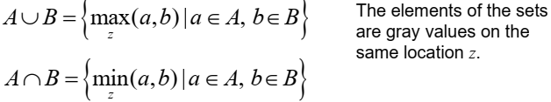
Preliminaries
The above operations assume that the images containing the sets are binary and involve only the pixel location.
Union and intersection are different when we define set operations involving intensity values:

Slide 10
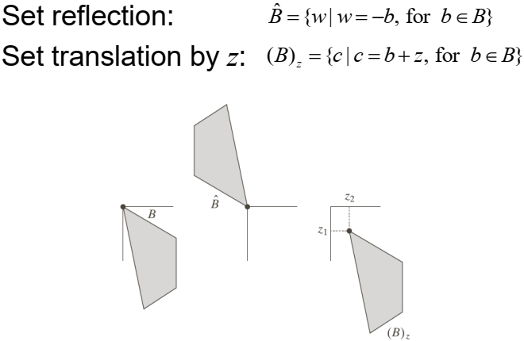
Preliminaries

Slide 11
Preliminaries
Set reflection and translation are employed to Structuring Elements - SE.
SE are small sets or sub-images used to examine the image under study for properties of interest.
The matrix dimensions of the SE specify the size of the structuring element.
The pattern of ones and zeros in the SE specifies the shape of the structuring element.
An origin of the SE is usually one of its pixels, although generally the origin can be outside the structuring element.
The origin must be specified. Zeros are appended to SE to give them a rectangular form.
Note: gray color represents a value of one and white color a zero value.

Slide 12
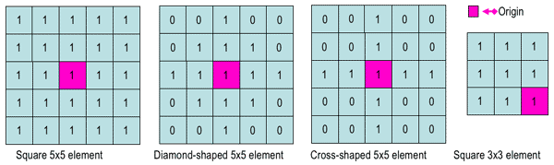
Preliminaries
A common practice is to have odd dimensions of the structuring matrix and the origin defined as the center of the matrix. Structuring elements play in morphological image processing the same role as convolution kernels in linear image filtering.

Slide 13
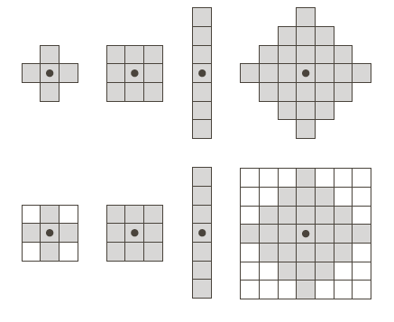
Preliminaries

Slide 14
Preliminaries
The origin of the SE B visits every pixel in an image A. It performs an operation (generally non linear) between its elements and the pixels under it.
It is then decided if the pixel will belong to the resulting set or not based on the results of the operation.
Zero padding is necessary (like in convolution) to ensure that all of the elements of A are processed.

Slide 15
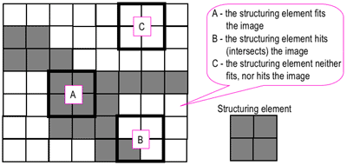
Hits & Fits
Some operations test whether the element "fits" within the neighborhood, while others test whether it "hits" or intersects the neighborhood:

Slide 16
Hits & Fits
When a SE is placed in a binary image, each of its pixels is associated with the corresponding pixel of the neighborhood under the SE.
The SE is said to fit the image if, for each of its pixels set to 1, the corresponding image pixel is also 1.
A SE is said to hit, or intersect, an image if, at least for one of its pixels set to 1 the corresponding image pixel is also 1.
Zero-valued pixels of the SE are ignored, i.e. indicate points where the corresponding image value is irrelevant.

Slide 17
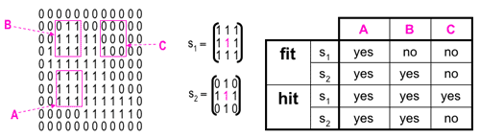
Hits & Fits

Slide 18
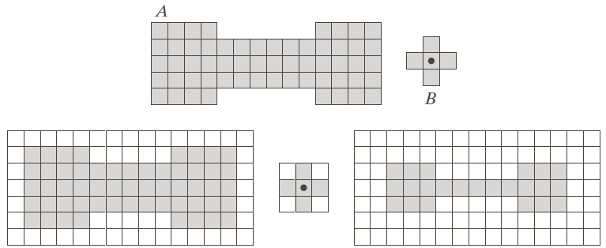
Hits & Fits
For example, it marks the pixel under its center as belonging to the result if B is completely contained in A.

Slide 19
Morphological Operations
Some basic operations:
Erosion.
Dilation.
Opening.
Closing.
Applications:
Morphological filtering.
The hit-or-miss transformation.

Slide 20
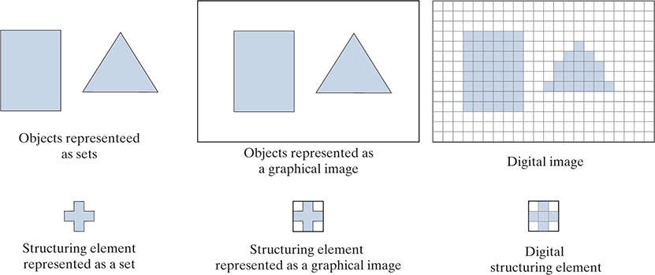
Morphological Operations

Slide 21
Erosion
The erosion of a binary image f by an SE s (denoted f⊖s) produces a new binary image g = f⊖s with ones in all locations (x, y) of an SE's origin at which that SE s fits the input image f, i.e. g(x, y) = 1 if s fits f, and 0 otherwise, repeating for all pixel coordinates (x, y):
Equivalently, erosion can be defined by: f⊖s = { z | (s)_{z} ⊆ A}

Slide 22
Erosion
Erosion is a shrinking operation

Slide 23
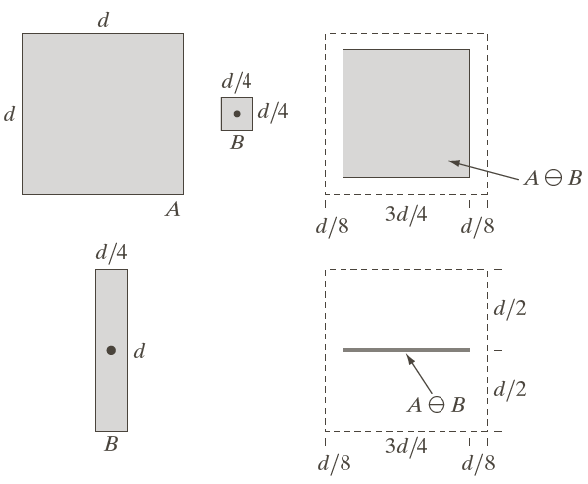
Erosion

Slide 24

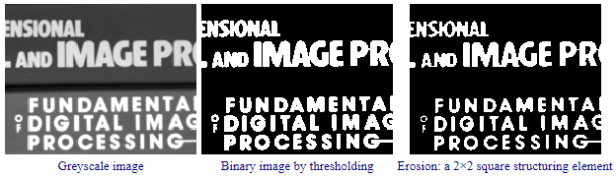
Erosion
Original image
Erosion by 3*3 square structuring element
Erosion by 5*5 square structuring element

Slide 25

Erosion
Erosion: a 3×3 square structuring element

Slide 26
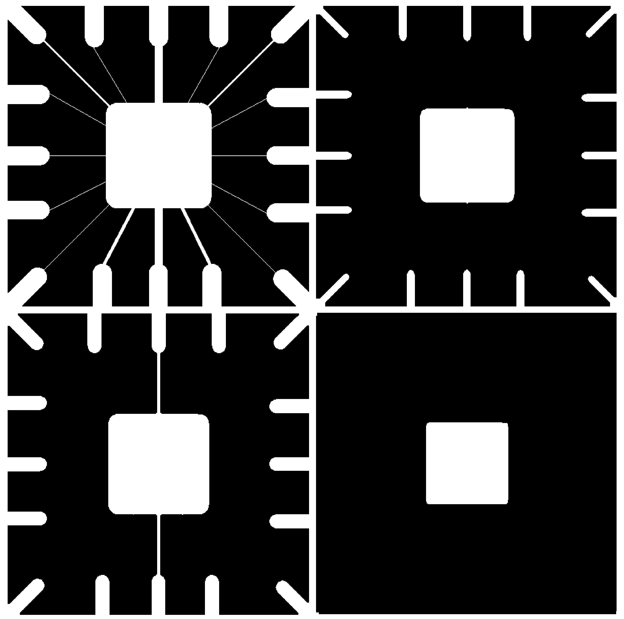
Erosion
Original image
After erosion with a disc of radius 10
After erosion with a disc of radius 5
After erosion with a disc of radius 20

Slide 27
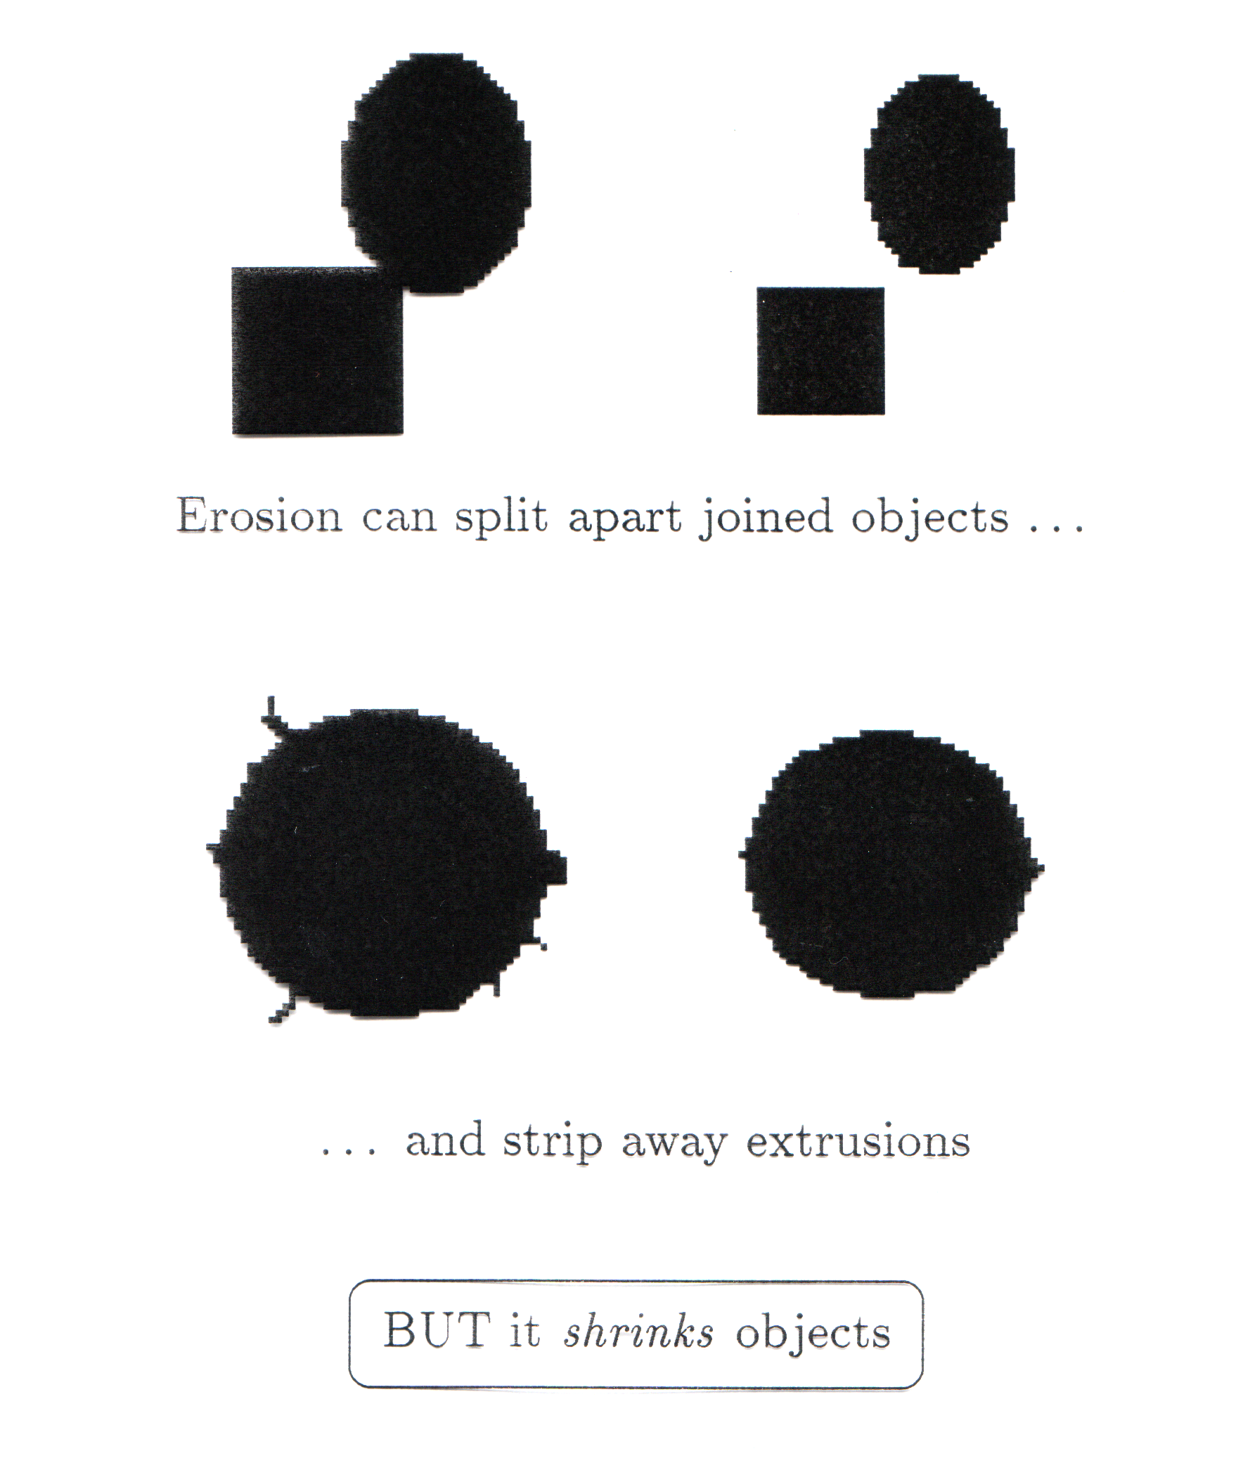
Erosion
Erosion can split apart joined objects
Erosion can strip away extrusions
Watch out: Erosion shrinks objects

Slide 28
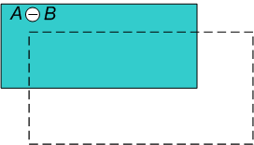

Erosion: Practice 1

Slide 29
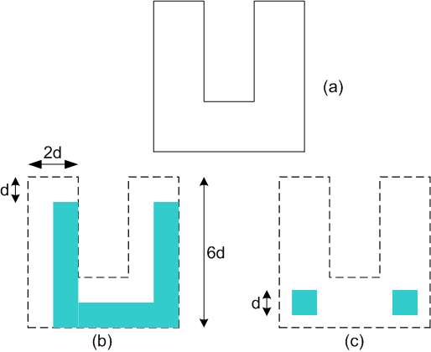
Erosion: Practice 2
Find suitable SEs to get (b), (c) from (a):

Slide 30
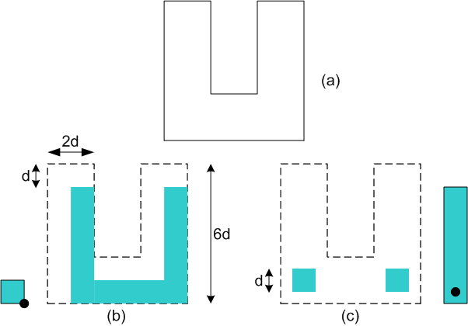
Erosion: Practice 1

Slide 31
Dilation
The dilation of an image f by an SE s (denoted f⊕s) produces a new binary image g = f⊕s with ones in all locations (x, y) of an SE's origin at which that SE s hits the input image f, i.e. g(x, y) = 1 if s hits f and 0 otherwise, repeating for all pixel coordinates (x, y).
Dilation has the opposite effect to erosion - it adds a layer of pixels to both the inner and outer boundaries of regions.

Slide 32
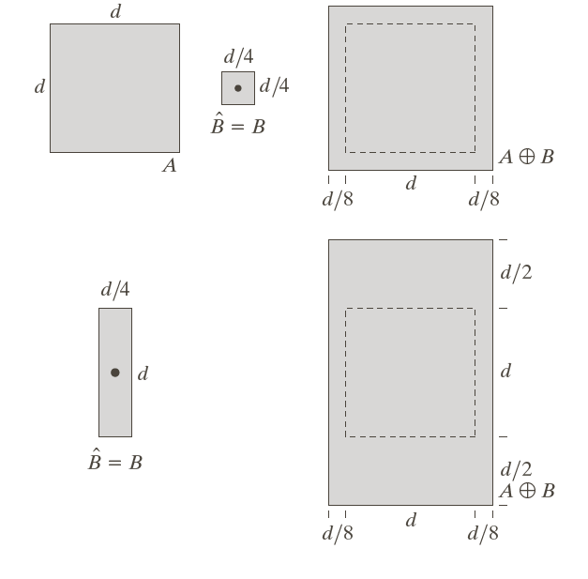
Dilation
Dilation is a thickening operation

Slide 33

Dilation
Original image
Dilation by 3*3 square structuring element
Dilation by 5*5 square structuring element

Slide 34
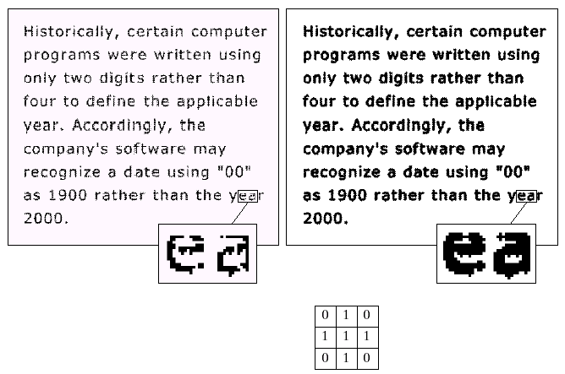
Dilation
Original image
After dilation
SE

Slide 35
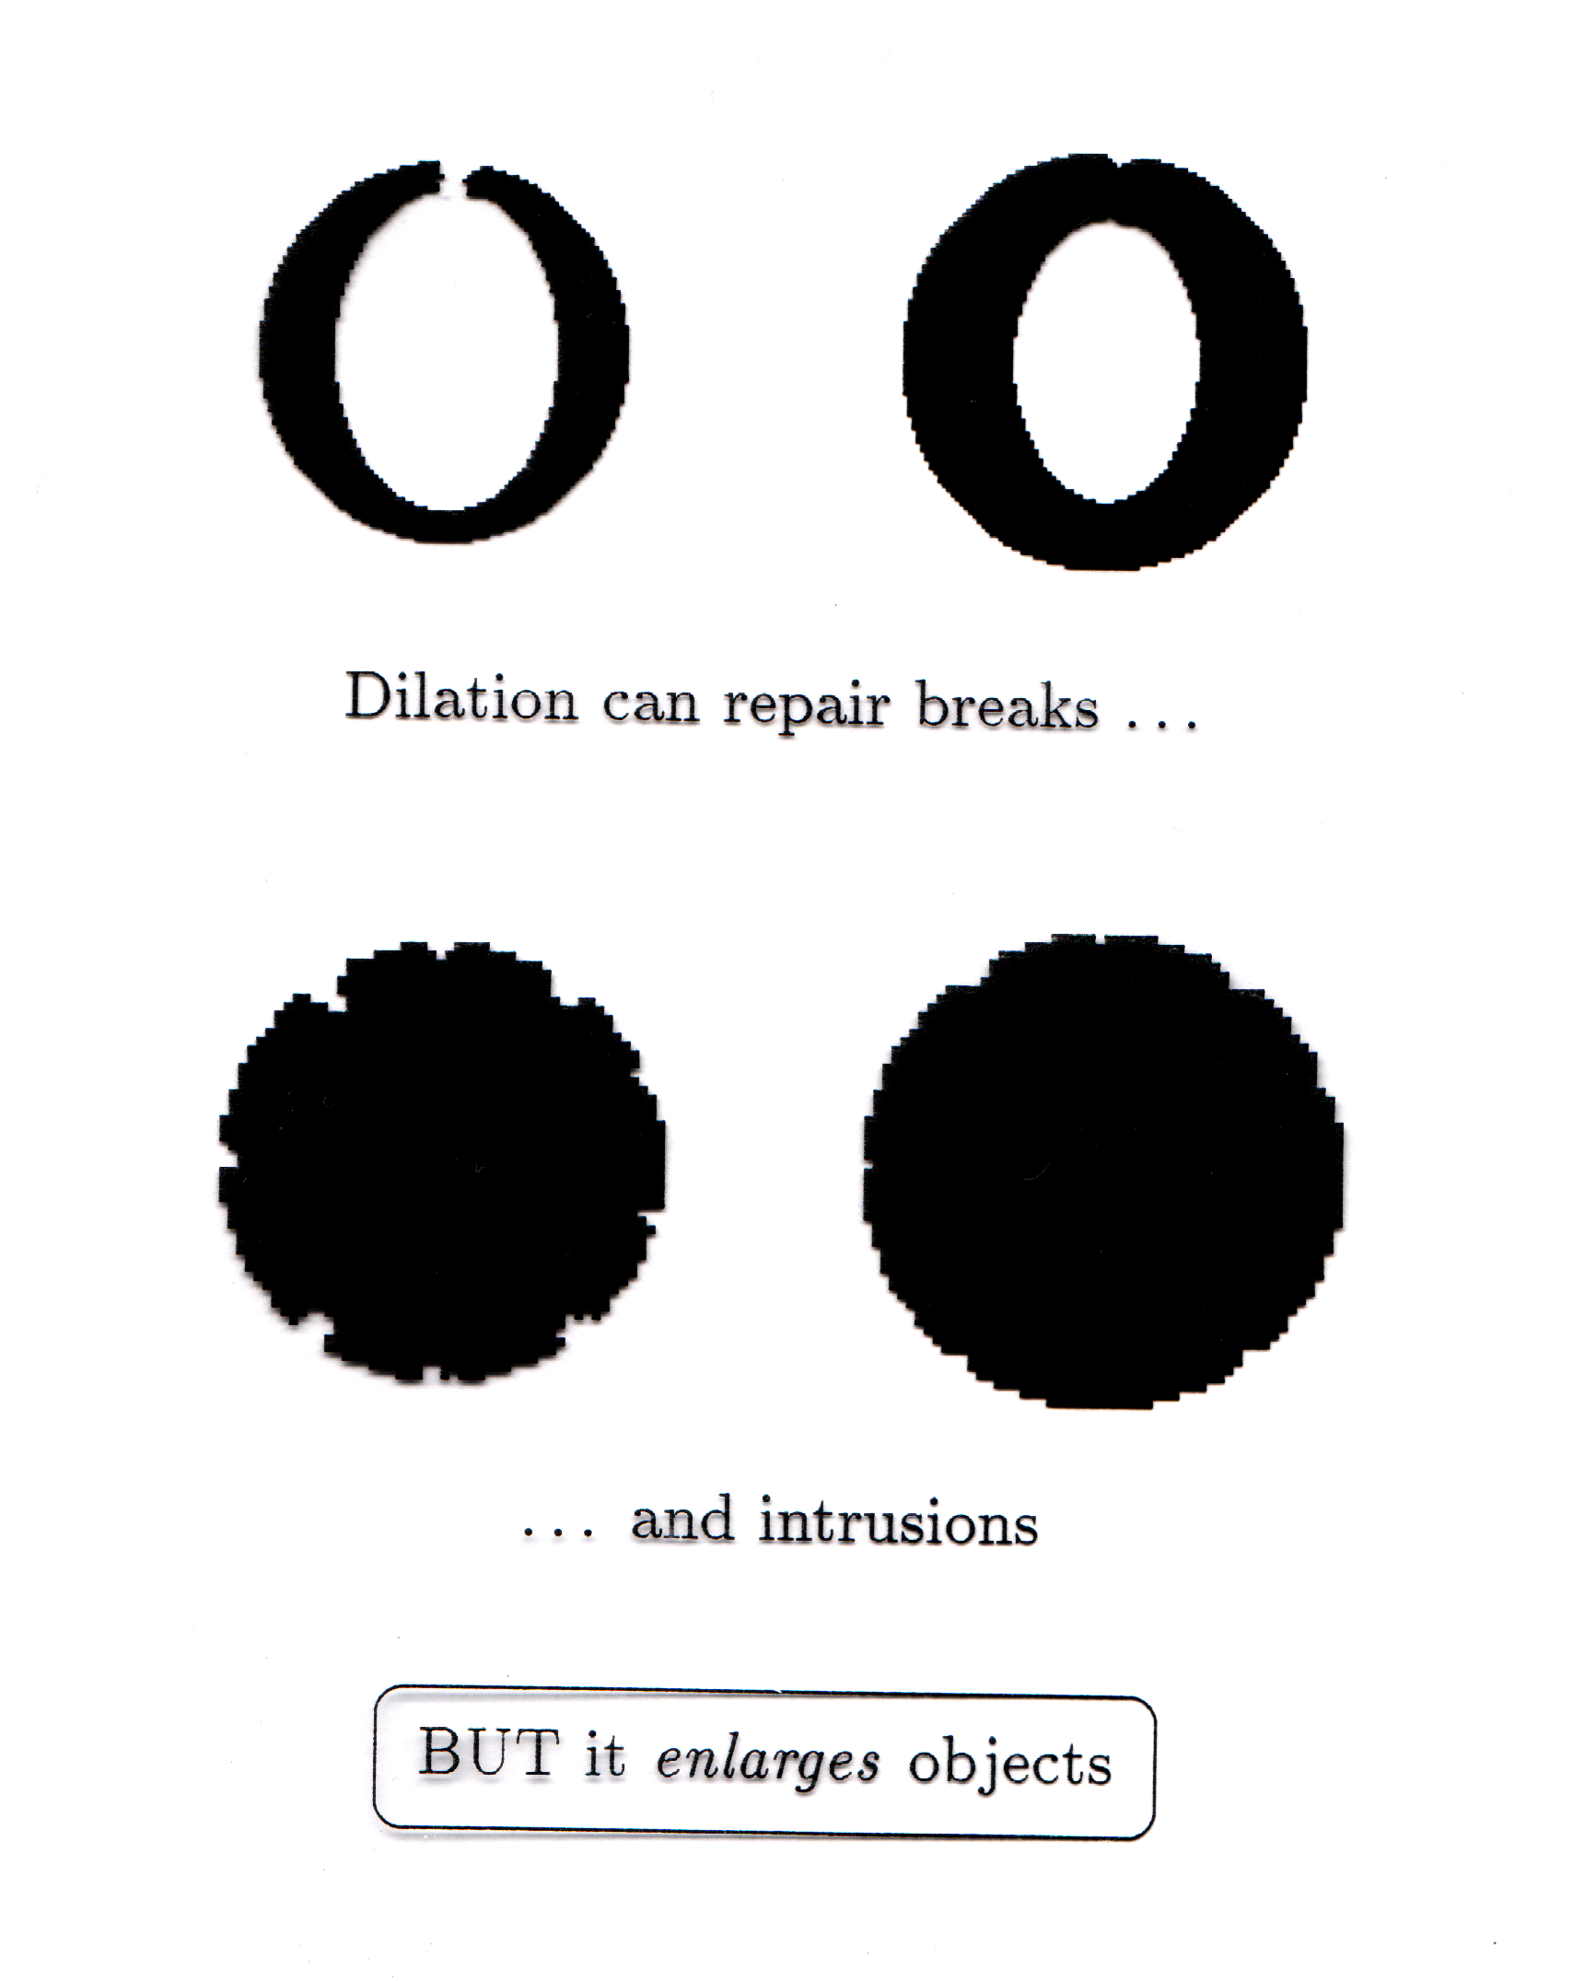
Dilation
Dilation can repair breaks
Dilation can repair intrusions
Watch out: Dilation enlarges objects

Slide 36
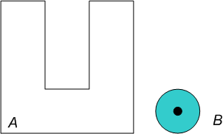
Dilation
Find the result of of dilation where SE is B and the image is A:

Slide 37
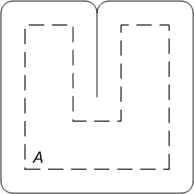
Dilation
Result:

Slide 38
Compound Operations
More interesting morphological operations can be performed by combining erosions and dilations in order to reduce shrinking or thickening.
The most widely used of these compound operations are:
Opening
Closing

Slide 39
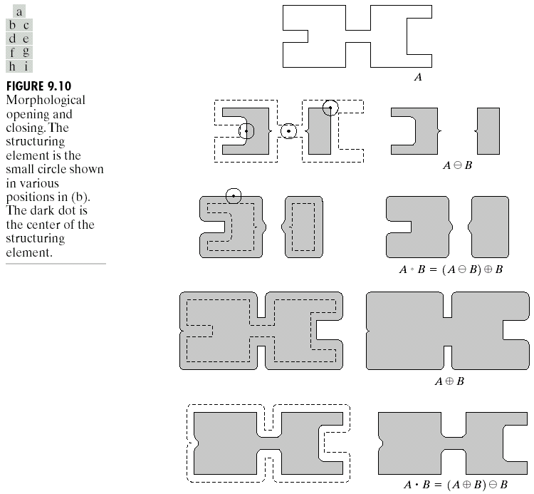
Opening
The opening of image f by structuring element – SE s is defined as:
f ○ s = ( f ⊖ s) ⊕ s
which is an erosion of A by B followed by a dilation of the result by B.
Original shape
After erosion
After dilation (opening)
Note a disc shaped structuring element is used

Slide 40


Opening
Original image
Image after opening

Slide 41
Opening
Morphological opening involves the application of erosion, followed by dilation.
The effects are:
Smooth boundaries
Break narrow isthmuses
Eliminate small noise regions.
Separate connected objects
Remove small objects.

Slide 42
Opening
When a circular structuring element is used for opening:
The analogy is often made of the shape of the opening being determined by a “rolling ball” reaching as far as it can on the inner boundary of a set.
For morphological closing the ball rolls outside, and the shape of the closing is determined by how far the ball can reach into the boundary

Slide 43
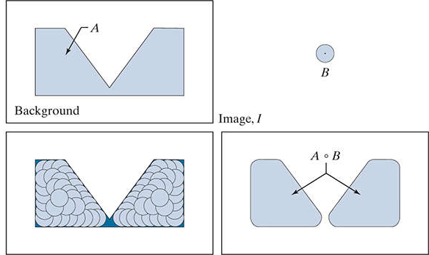
Opening

Slide 44
Closing
The closing of an image f by an SE s (denoted by f • s) is defined by:
f • s = ( f ⊕ s) ⊖ s
which is a dilation followed by an erosion:
Original shape
After dilation
After erosion (closing)
Note a disc shaped structuring element is used

Slide 45

Closing
Original image
Image after closing

Slide 46
Closing
Morphological closing involves the application of dilation, followed by erosion.
The effects are:
Smooth boundaries
Join narrow breaks
Fill small holes caused by noise.
Connect disconnected objects.

Slide 47
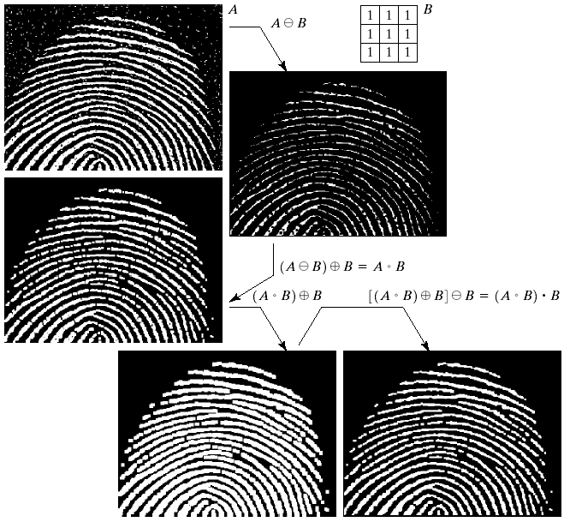
Compound Operations

Slide 48
Morphological Algorithms
Using these morphological operations we may extract image components for shape representation:
Shape boundaries.
Region filling.
Connected components
Convex hull.
Shape thinning and thickening.
Skeletons.
We may also accomplish a morphological image reconstruction.

Slide 49
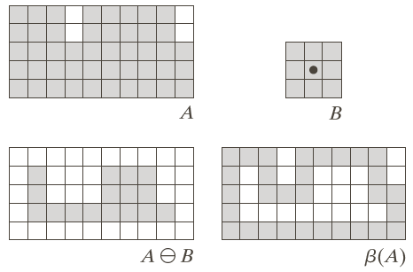
Boundary Extraction
The boundary of a set A, denoted by β(A), may be obtained by:
β(A) = A – (A ⊖ B)
where B is an SE.

Slide 50
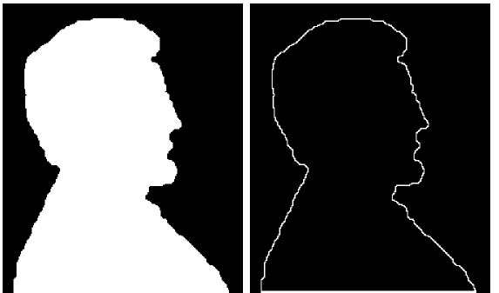
Boundary Extraction
Original Image Extracted Boundary
The boundary is one pixel thick due to the 3x3 SE. Other SE would result in thicker boundaries.

Slide 51

Region Filling
Given a pixel inside a boundary, region filling attempts to fill the area surrounded by that boundary with 1s.
Given a point inside here, can we fill the whole circle?

Slide 52
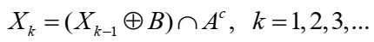
Region Filling: Algorithm
Form a set X₀ with zeros everywhere except at the seed point of the region A.
Then:
where B is a 3x3 cross-shaped SE.
The algorithm terminates when X_{k} = X_{k-1}.
The set union of X_{k} and A contains all the filled holes and their boundaries.
The intersection of the result with A_{c} limits the result inside the region of interest.

Slide 53
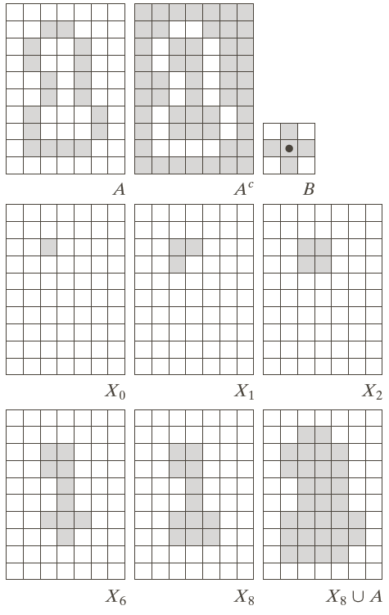
Region Filling

Slide 54
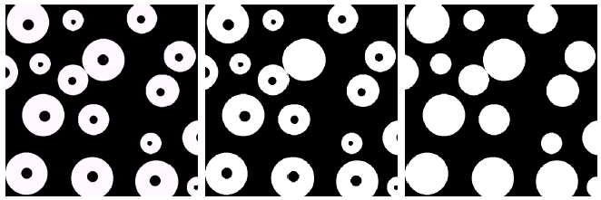
Region Filling
Original Image
One Region Filled
All Regions Filled

Slide 55
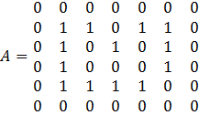
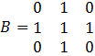
Region Filling: Practice
Bài tập 5
Given an image A. Fill the hole in the image A using the morphological hole filling algorithm with an SE B.

